Slide 1
Artificial Neural Networks
اَعُوذُ بِاللہِ مِنَ الشَّیِطٰنِ الرَّجِیمْ
بِسْمِ اللہِ الرَّحَمٰنِ الرَّحِیمْ
Note: Some slides and/or pictures are adapted from Lecture slides / Books of
https://www.coursera.org/specializations/deep-learning
https://d2l.ai/chapter_preface/index.html
https://deeplearning.cs.cmu.edu/S23/index.html

Slide 2
Contents
Intuition about derivatives
Finding Minima and Maxima
Gradient Descent
Impact of learning rate in Gradient Descent
How to implement Gradient Descent
Gradient Descent for Linear Regression

Slide 3
Intuition Behind Derivatives

Slide 4
Derivatives
f(x) = 4x
f(x) = x³
f(x) = (x + 2)⁴
f(x) = (3x + 2y + 2)²

Slide 5
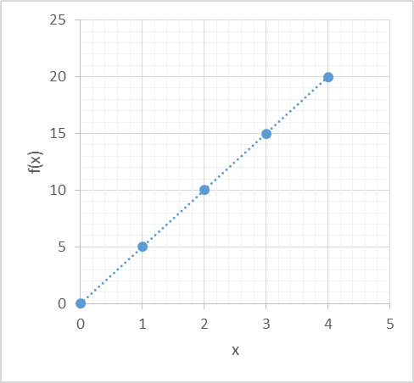
Slope of line
x | f(x)
0 | 0
1 | 5
2 | 10
3 | 15
4 | 20
2, f(2)
1, f(1)

Slide 6
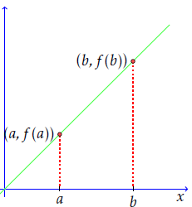
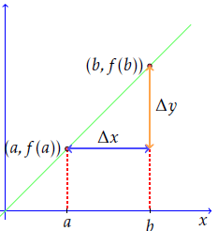
Slope of line
Δx=b-a Δy = f(b) - f(a) slope = Δy / Δx

Slide 7
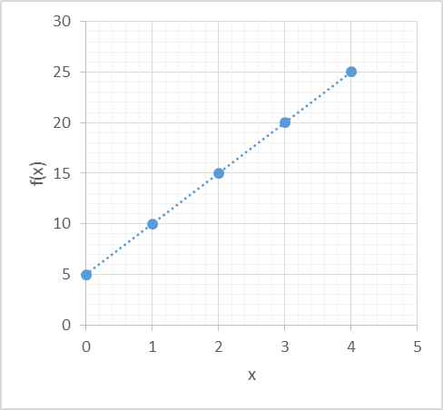
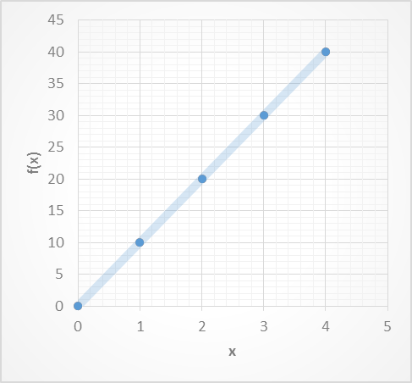
Slope of line
x | f(x)
0 | 5
1 | 10
2 | 15
3 | 20
4 | 25
x | f(x)
0 | 0
1 | 10
2 | 20
3 | 30
4 | 40
Notes:
For example, in the figure below, we show two lines. In the two, we take a Δx of the same length. You can see that the first line has a smaller corresponding Δy.
So, the quotient m will be much smaller for the first line. This corresponds to our intuition of steepness: clearly the second line is steeper than the first, so its slope is larger.

Slide 8
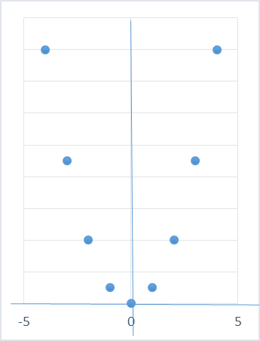
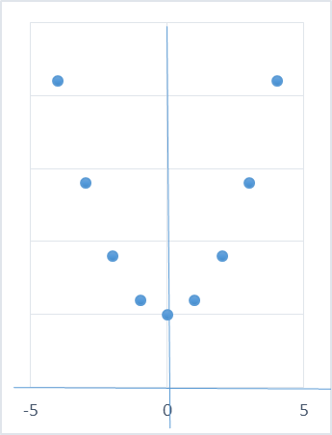
The Slope of a Curve
f(x) = x²
f(x) = x² + 5
x | f(x)
0 | 0
1 | 1
-1 | 1
2 | 4
-2 | 4
3 | 9
-3 | 9
4 | 16
-4 | 16
x | f(x)
0 | 5
1 | 6
-1 | 6
2 | 9
-2 | 9
3 | 14
-3 | 14
4 | 21
-4 | 21
Notes:
As we did to define the slope of a straight line, we now take two points from the curve. I'll start using the notation normally used in calculus.

Slide 9
Q & A

Slide 10
Finding Minima and Maxima

Slide 11
Finding Minima and Maxima
f(x) = x² + 5
x | f(x)
0 | 5
1 | 10
2 | 15
3 | 20
4 | 25
x | f(x)
0 | 5
1 | 6
-1 | 6
2 | 9
-2 | 9
3 | 14
-3 | 14
4 | 21
-4 | 21
Notes:
For example, in the figure below, we show two lines. In the two, we take a Δx of the same length. You can see that the first line has a smaller corresponding Δy.
So, the quotient m will be much smaller for the first line. This corresponds to our intuition of steepness: clearly the second line is steeper than the first, so its slope is larger.

Slide 12
Finding Minima and Maxima
f(x) = x²
f(x) = x² + 5
x | f(x)
0 | 0
1 | 1
-1 | 1
2 | 4
-2 | 4
3 | 9
-3 | 9
4 | 16
-4 | 16
x | f(x)
0 | 5
1 | 6
-1 | 6
2 | 9
-2 | 9
3 | 14
-3 | 14
4 | 21
-4 | 21
Notes:
As we did to define the slope of a straight line, we now take two points from the curve. I'll start using the notation normally used in calculus.

Slide 13
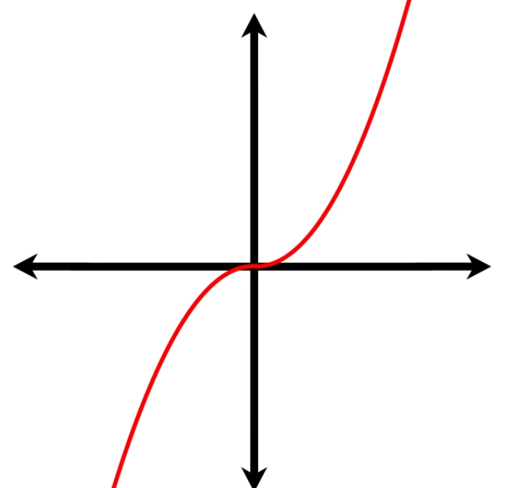
Finding Minima and Maxima
f(x) = x³ has no maxima/minima

Slide 14
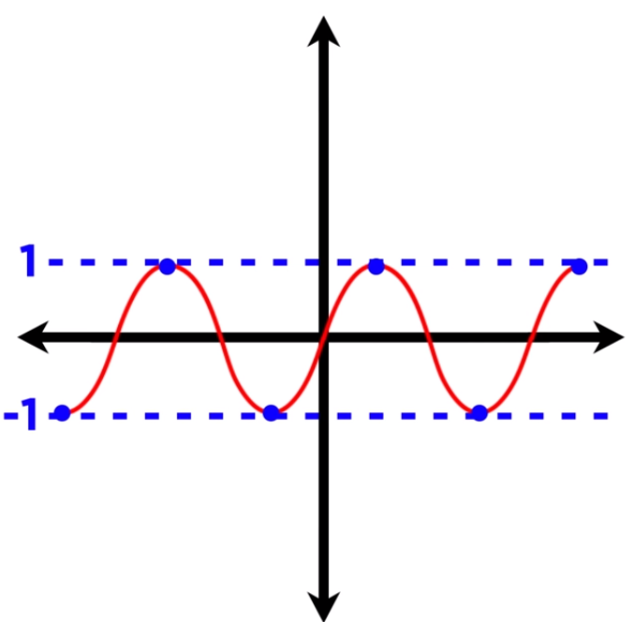
Finding Minima and Maxima
f(x) = sin(x) has an absolute maximum and absolute minimum

Slide 15
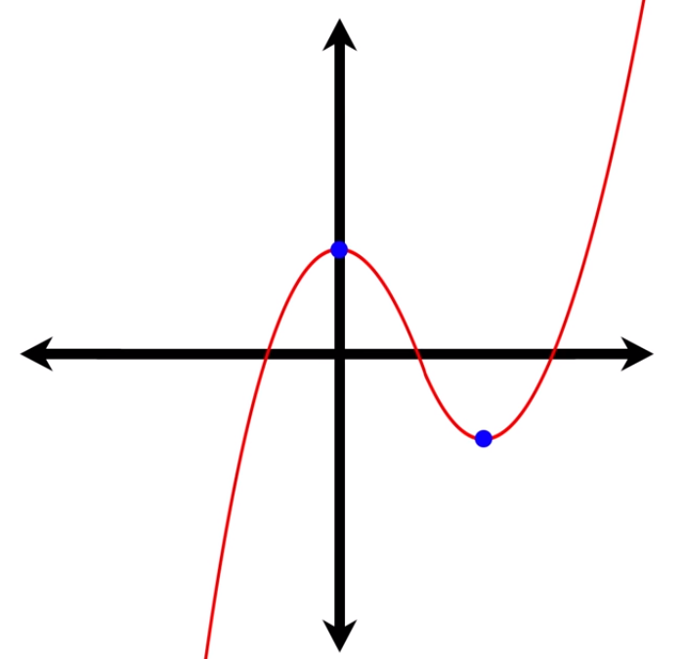
Finding Minima and Maxima
f(x) = x³ – 3x² + 1
f’(x) = 3x² - 6x
f’(x) = 3x(x-2)
3x (x-2) = 0
x = 0, 2
f’(0) = 0, f’(2) = 0

Slide 16
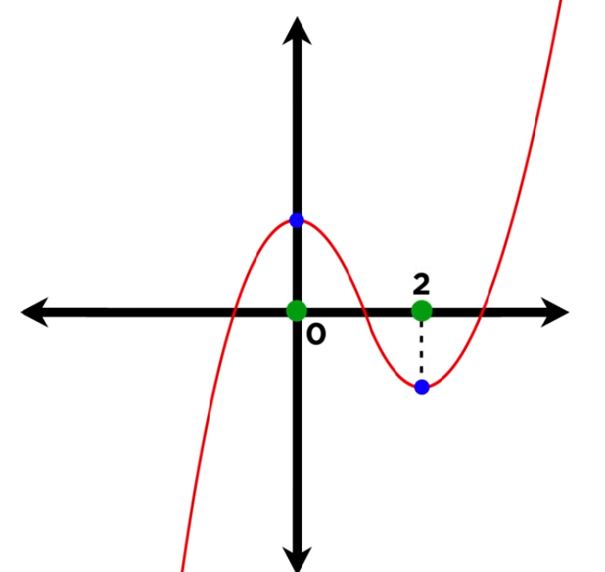
Finding Minima and Maxima
f(x) = x³ – 3x² + 1
f’(x) = 3x² - 6x
f’(x) = 3x(x-2)
3x (x-2) = 0
x = 0, 2
f’(0) = 0, f’(2) = 0

Slide 17
Q & A

Slide 18
Gradient Descent

Slide 19
Gradient Descent is just like Agile Methodology
Build something quickly
Get it out there
Get some feedback
Make changes depending upon the feedback

Slide 20
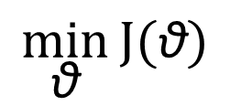
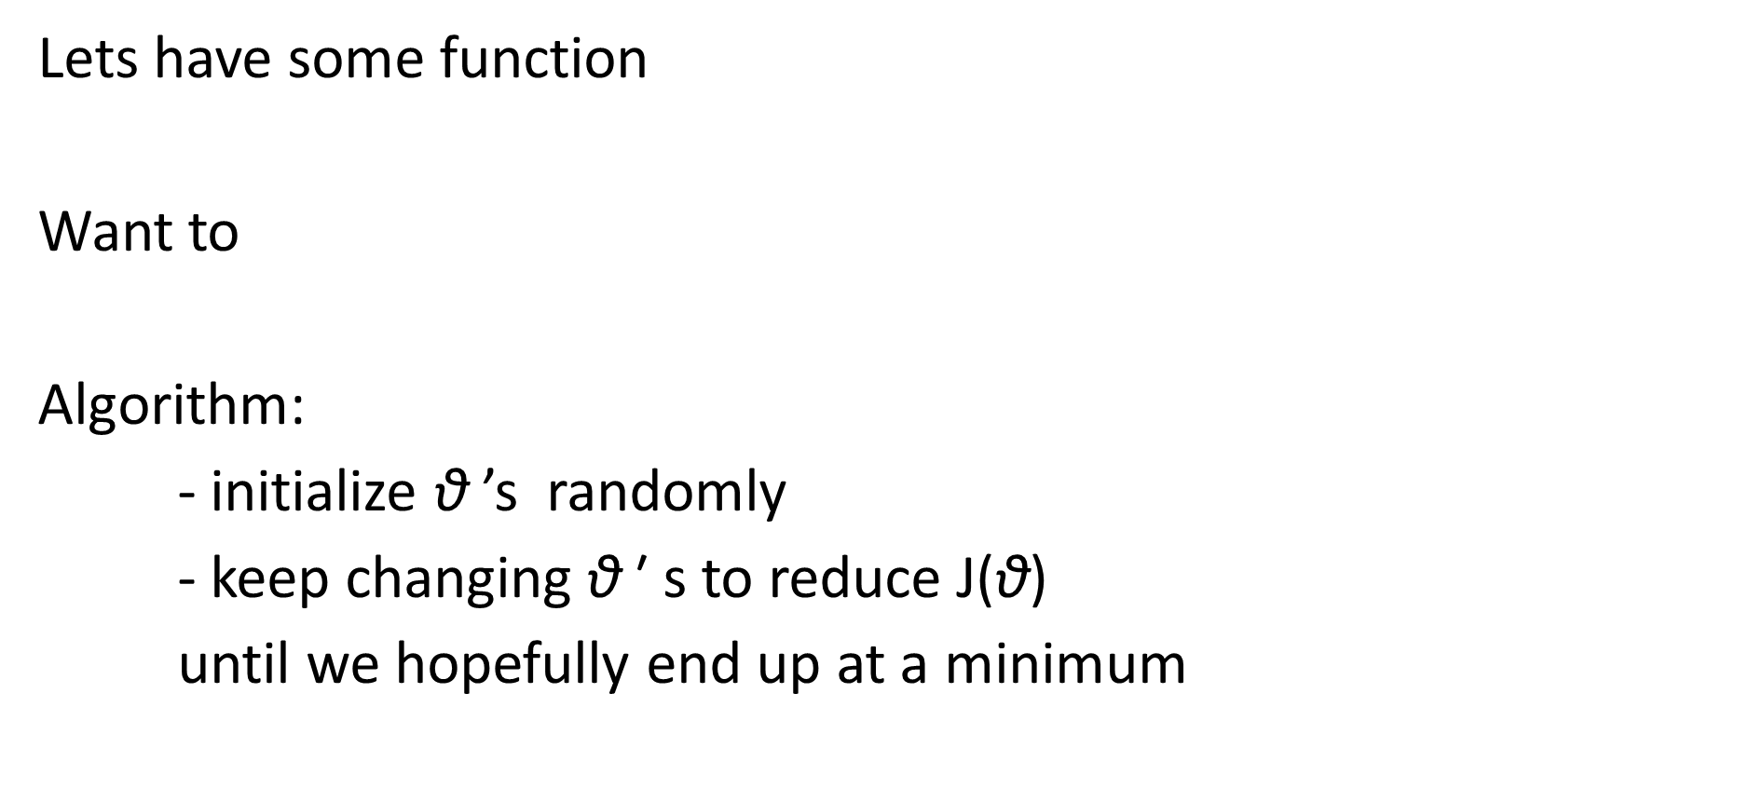
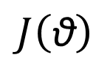
Gradient Descent
$$J\left(\text{θ}\right)$$
Lets have some function
Want to
Algorithm:
- initialize $\text{θ}$ ’s randomly
- keep changing $\text{θ} \text{′ }\text{s}$ to reduce J($\text{θ}$)
until we hopefully end up at a minimum
$$\min_{\text{θ}}{J(\text{θ})}$$

Slide 21
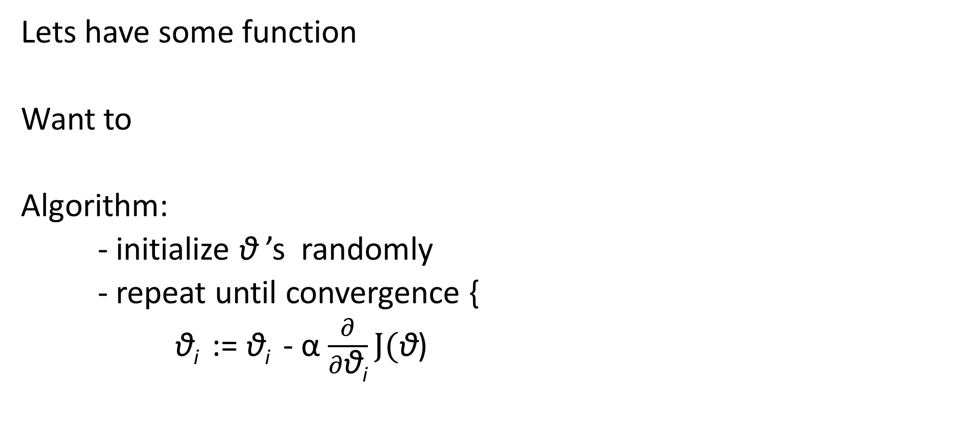
Gradient Descent
$$J\left(\text{θ}\right)$$
Lets have some function
Want to
Algorithm:
- initialize $\text{θ}$ ’s randomly
- repeat until convergence {
$\text{θ}\text{i}$ := $\text{θ}\text{i}$ - α $\frac{∂}{∂\text{θ}\text{i}}J(\text{θ}$)
$$\min_{\text{θ}}{J(\text{θ})}$$

Slide 22
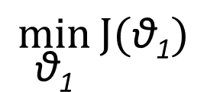
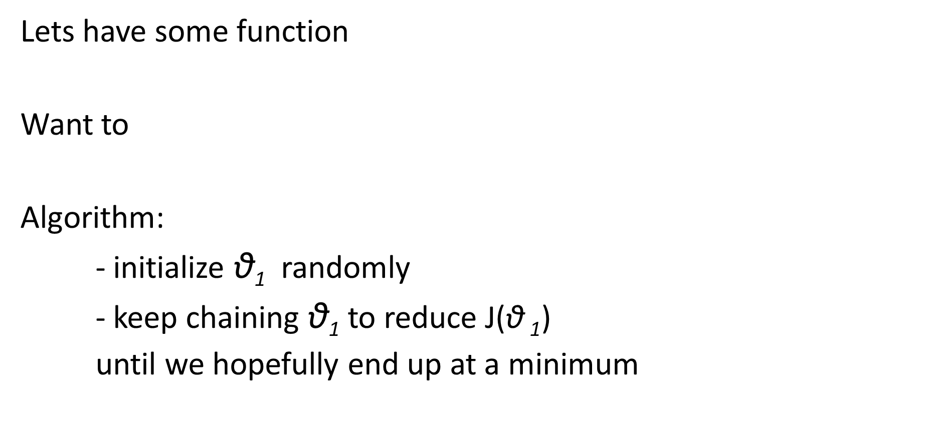
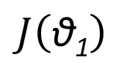
Gradient Descent
$$J\left(\text{θ}\text{1}\right)$$
Lets have some function
Want to
Algorithm:
- initialize $\text{θ}\text{1}$ randomly
- keep chaining $\text{θ}\text{1}$ to reduce J($\text{θ}$ $\text{1}$)
until we hopefully end up at a minimum
$$\min_{\text{θ}\text{1}}{J(\text{θ}\text{1})}$$

Slide 23
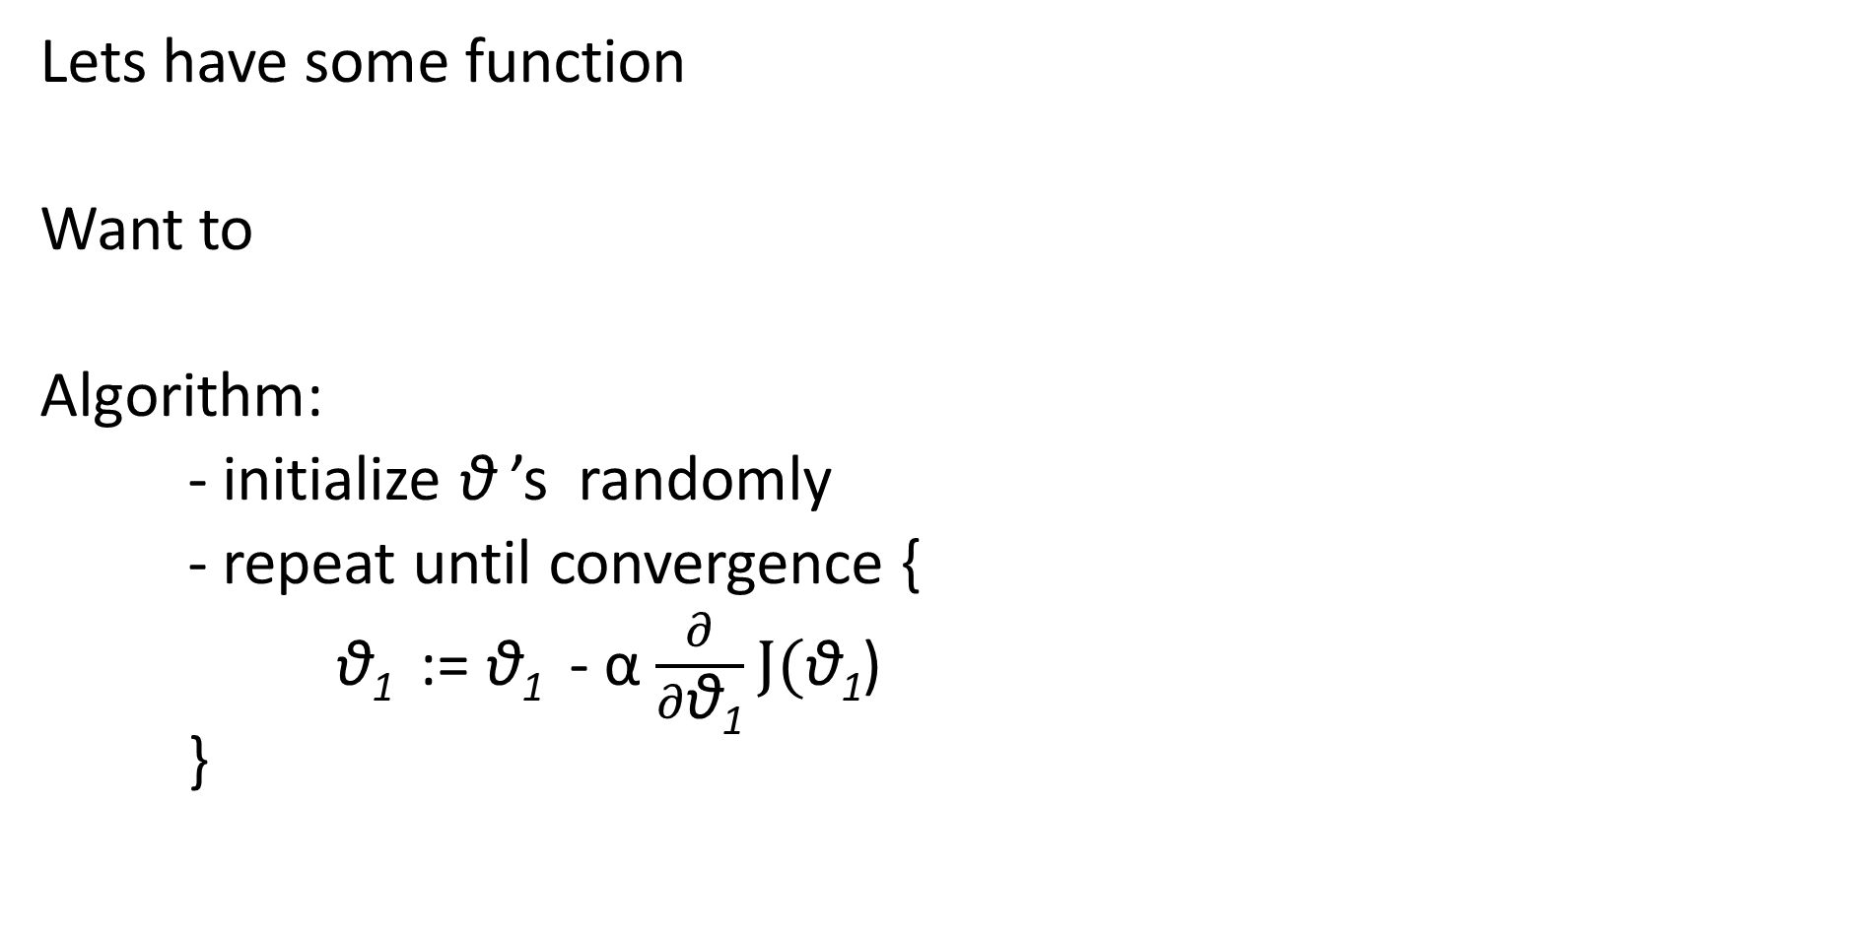
Gradient Descent
$$J\left(\text{θ}\text{1}\right)$$
Lets have some function
Want to
Algorithm:
- initialize $\text{θ}$ ’s randomly
- repeat until convergence {
$\text{θ}\text{1}$ := $\text{θ}\text{1}$ - α $\frac{∂}{∂\text{θ}\text{1}}J(\text{θ}\text{1}$)
}
$$\min_{\text{θ}\text{1}}{J(\text{θ}\text{1})}$$

Slide 24
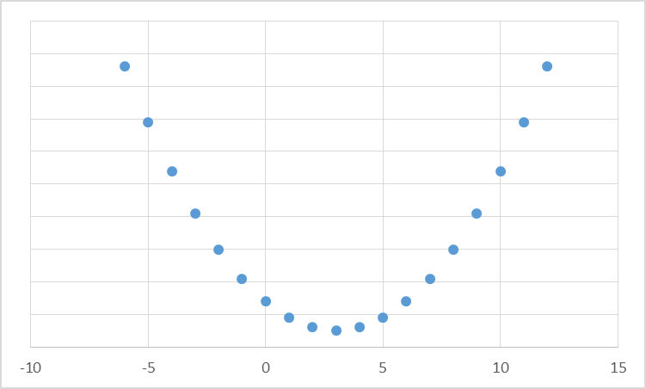
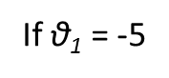
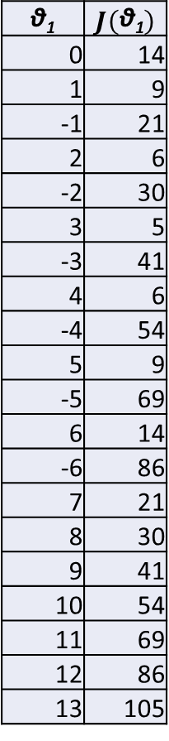
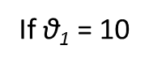
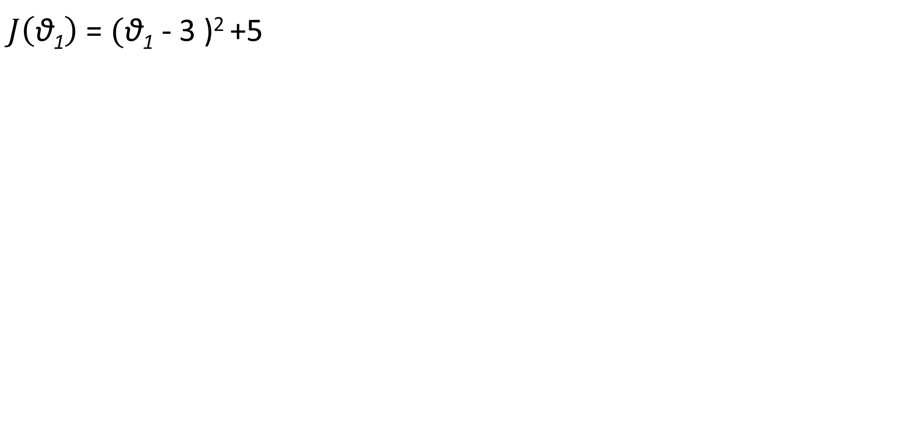
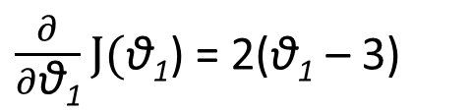
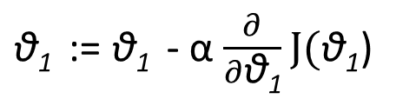
Gradient Descent
$J\left(\text{θ}\text{1}\right)$ = $(\text{θ}\text{1}$ - 3 )² +5
$\text{θ}\text{1}$ := $\text{θ}\text{1}$ - α $\frac{∂}{∂\text{θ}\text{1}}J(\text{θ}\text{1}$)
$$\text{θ}\text{1}$$ | $$J\left(\text{θ}\text{1}\right)$$
0 | 14
1 | 9
-1 | 21
2 | 6
-2 | 30
3 | 5
-3 | 41
4 | 6
-4 | 54
5 | 9
-5 | 69
6 | 14
-6 | 86
7 | 21
8 | 30
9 | 41
10 | 54
11 | 69
12 | 86
13 | 105
$\frac{∂}{∂\text{θ}\text{1}}J(\text{θ}\text{1}$) = 2($\text{θ}\text{1}$ – 3)
α = 0.1
If $\text{θ}\text{1}$ = 10
If $\text{θ}\text{1}$ = -5

Slide 25
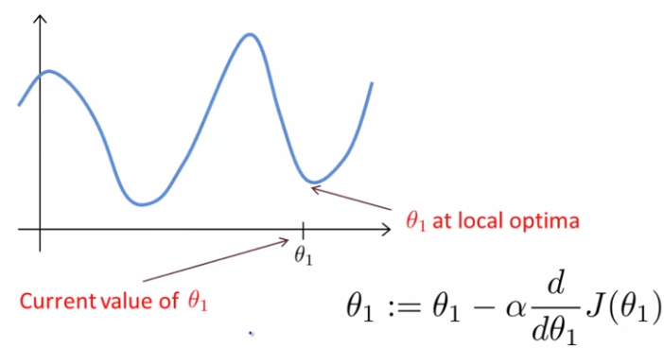
Gradient Descent

Slide 26
Q & A

Slide 27
Impact of learning rate in Gradient Descent

Slide 28
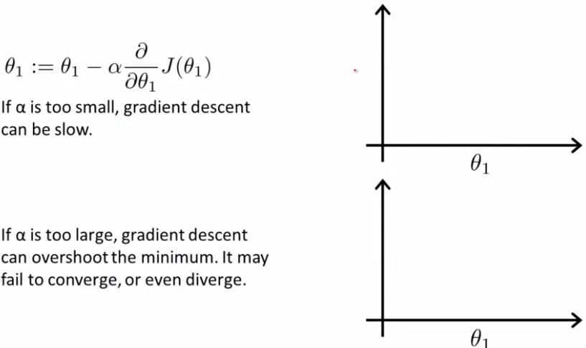
Impact of learning rate in Gradient Descent

Slide 29
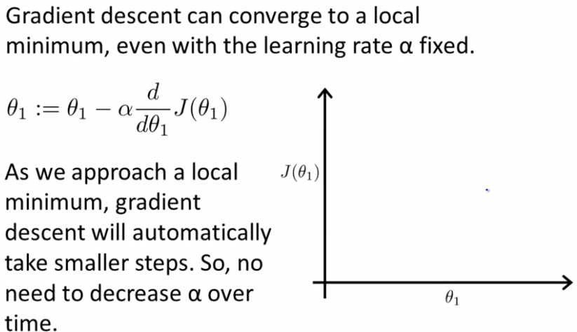
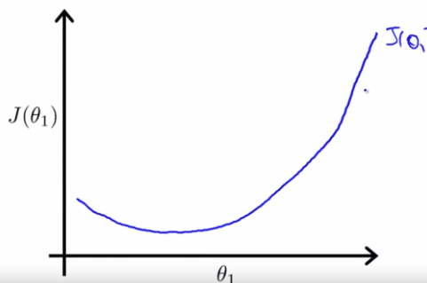
Impact of learning rate in Gradient Descent

Slide 30
Q & A

Slide 31
How to implement Gradient Descent

Slide 32
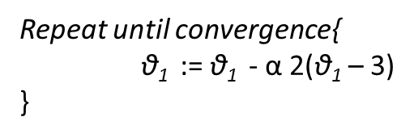
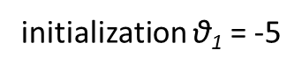
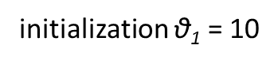
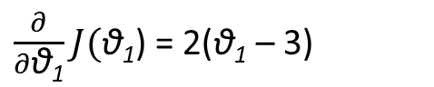
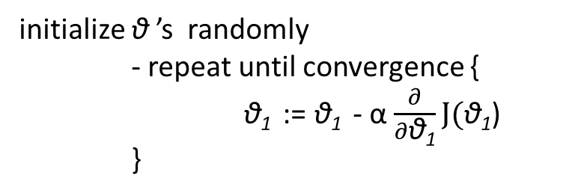
How to implement Gradient Descent
$J\left(\text{θ}\text{1}\right)$ = $(\text{θ}\text{1}$ - 3 )² +5
initialize $\text{θ}$ ’s randomly
- repeat until convergence {
$\text{θ}\text{1}$ := $\text{θ}\text{1}$ - α $\frac{∂}{∂\text{θ}\text{1}}J(\text{θ}\text{1}$)
}
$$\text{θ}\text{1}$$ | $$J\left(\text{θ}\text{1}\right)$$
0 | 14
1 | 9
-1 | 21
2 | 6
-2 | 30
3 | 5
-3 | 41
4 | 6
-4 | 54
5 | 9
-5 | 69
6 | 14
-6 | 86
7 | 21
8 | 30
9 | 41
10 | 54
11 | 69
12 | 86
13 | 105
$\frac{∂}{∂\text{θ}\text{1}}J(\text{θ}\text{1}$) = 2($\text{θ}\text{1}$ – 3)
initialization $\text{θ}\text{1}$ = 10
initialization $\text{θ}\text{1}$ = -5
Repeat until convergence{
$\text{θ}\text{1}$ := $\text{θ}\text{1}$ - α 2($\text{θ}\text{1}$ – 3)
}

Slide 33
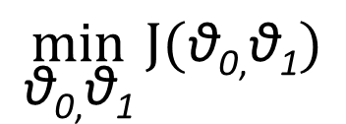
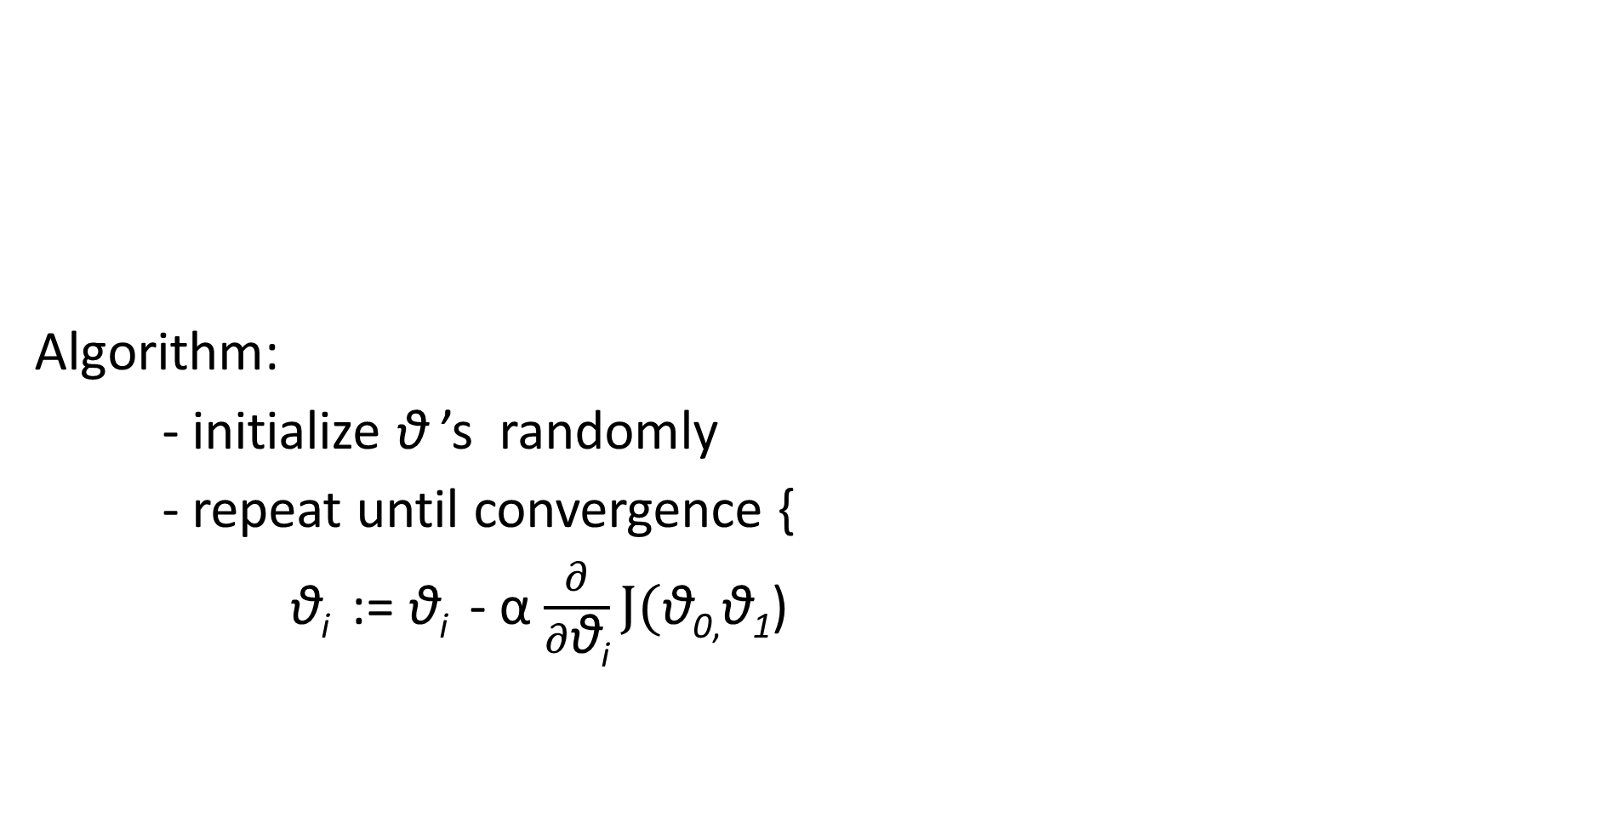
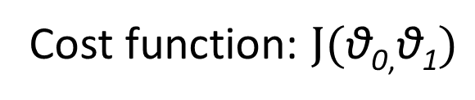
How to implement Gradient Descent
Algorithm:
- initialize $\text{θ}$ ’s randomly
- repeat until convergence {
$\text{θ}\text{i}$ := $\text{θ}\text{i}$ - α $\frac{∂}{∂\text{θ}\text{i}}J(\text{θ}\text{0}\text{,}\text{θ}\text{1}\text{)}$
Cost function: $J(\text{θ}\text{0}\text{,}\text{θ}\text{1})$
$$\min_{\text{θ}\text{0}\text{,}\text{θ}\text{1}}{J(\text{θ}\text{0}\text{,}\text{θ}\text{1})}$$

Slide 34
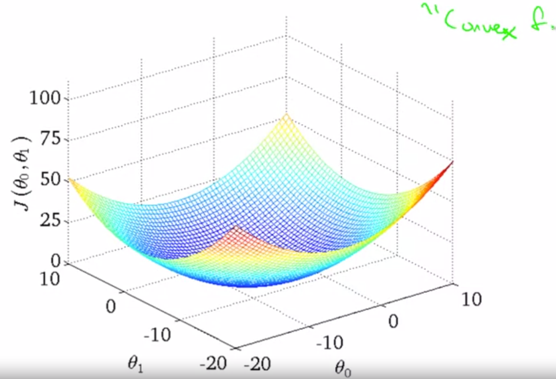
How to implement Gradient Descent

Slide 35
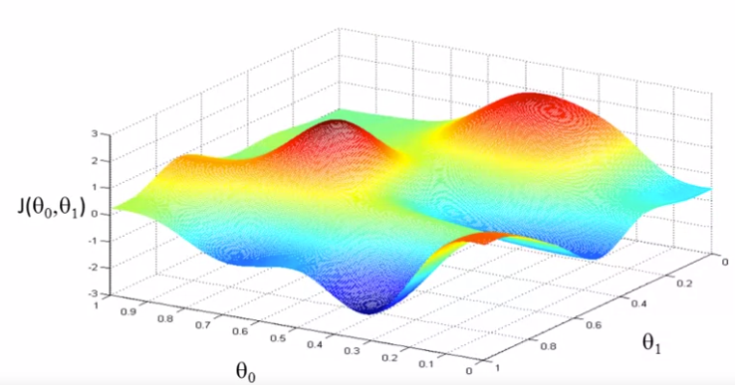
How to implement Gradient Descent

Slide 36
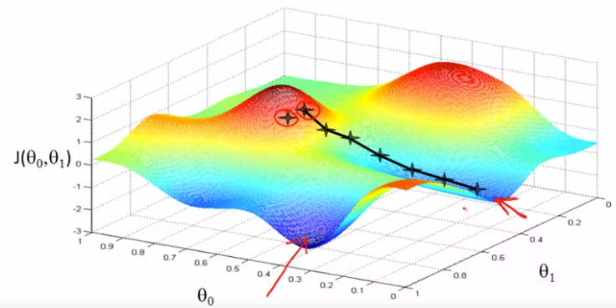
How to implement Gradient Descent

Slide 37
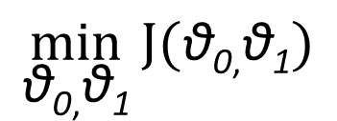
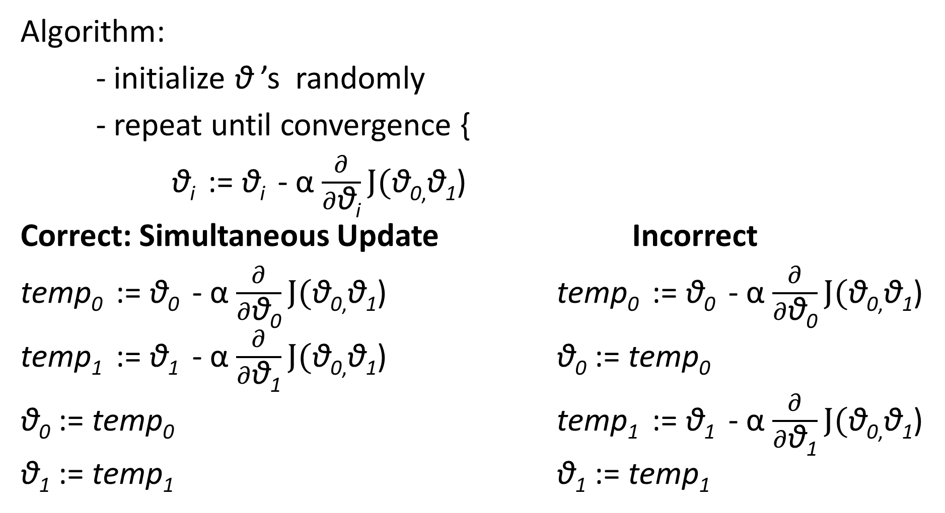
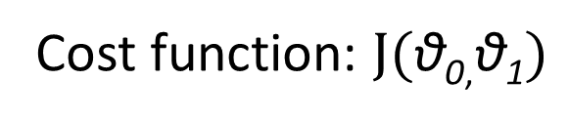
How to implement Gradient Descent
Cost function: $J(\text{θ}\text{0}\text{,}\text{θ}\text{1})$
Algorithm:
- initialize $\text{θ}$ ’s randomly
- repeat until convergence {
$\text{θ}\text{i}$ := $\text{θ}\text{i}$ - α $\frac{∂}{∂\text{θ}\text{i}}J(\text{θ}\text{0}\text{,}\text{θ}\text{1}\text{)}$
Correct: Simultaneous Update Incorrect
$\text{temp}\text{0}$ := $\text{θ}\text{0}$ - α $\frac{∂}{∂\text{θ}\text{0}}J(\text{θ}\text{0}\text{,}\text{θ}\text{1}\text{)}$ $\text{temp}\text{0}$ := $\text{θ}\text{0}$ - α $\frac{∂}{∂\text{θ}\text{0}}J(\text{θ}\text{0}\text{,}\text{θ}\text{1}\text{)}$
$\text{temp}\text{1}$ := $\text{θ}\text{1}$ - α $\frac{∂}{∂\text{θ}\text{1}}J(\text{θ}\text{0}\text{,}\text{θ}\text{1}\text{)}$ $\text{θ}\text{0}$ := $\text{temp}\text{0}$
$\text{θ}\text{0}$ := $\text{temp}\text{0}$ $\text{temp}\text{1}$ := $\text{θ}\text{1}$ - α $\frac{∂}{∂\text{θ}\text{1}}J(\text{θ}\text{0}\text{,}\text{θ}\text{1}\text{)}$
$\text{θ}\text{1}$ := $\text{temp}\text{1}$ $\text{θ}\text{1}$ := $\text{temp}\text{1}$
$$\min_{\text{θ}\text{0}\text{,}\text{θ}\text{1}}{J(\text{θ}\text{0}\text{,}\text{θ}\text{1})}$$

Slide 38
Q & A

Slide 39
Gradient Descent for Linear Regression

Slide 40
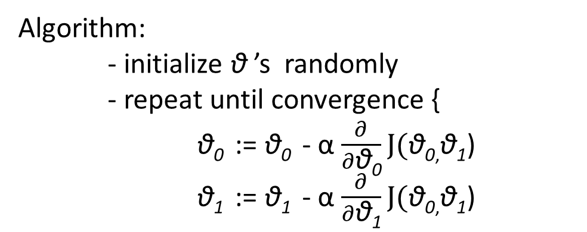
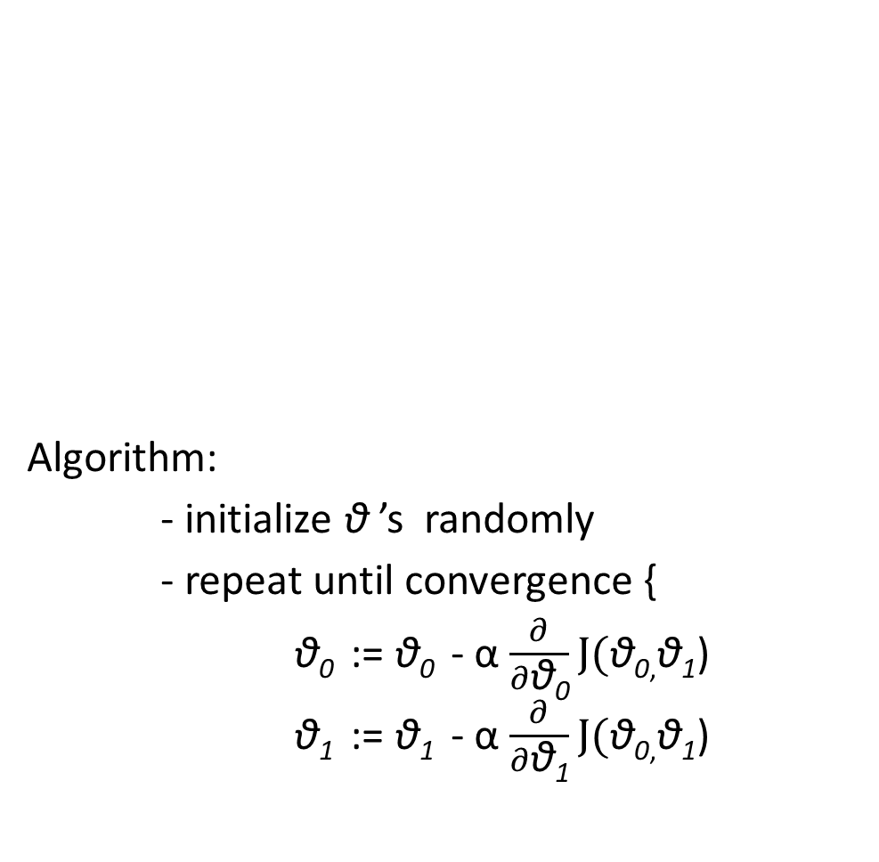
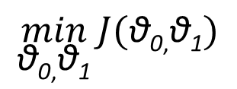
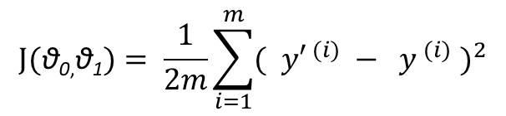
Gradient Descent for Linear Regression
Algorithm:
- initialize $\text{θ}$ ’s randomly
- repeat until convergence {
$\text{θ}\text{0}$ := $\text{θ}\text{0}$ - α $\frac{∂}{∂\text{θ}\text{0}}J(\text{θ}\text{0}\text{,}\text{θ}\text{1}\text{)}$
$\text{θ}\text{1}$ := $\text{θ}\text{1}$ - α $\frac{∂}{∂\text{θ}\text{1}}J(\text{θ}\text{0}\text{,}\text{θ}\text{1}\text{)}$
$$J(\text{θ}\text{0}\text{,}\text{θ}\text{1})= \frac{1}{2m}\sum_{i=1}^{m}{{( {y′}^{ (i)} − y^{ (i)} )}^{2}}$$
Cost function: $J(\text{θ}\text{0}\text{,}\text{θ}\text{1})$
$$\min_{\text{θ}\text{0}\text{,}\text{θ}\text{1}}{J(\text{θ}\text{0}\text{,}\text{θ}\text{1})}$$
$$\min_{\text{θ}\text{0}\text{,}\text{θ}\text{1}}{J(\text{θ}\text{0}\text{,}\text{θ}\text{1})}$$
Hypothesis : y’ ^{(i)} = h_{θ}(x^{(i)})=θ₀+θ₁x^{(i)}
Algorithm:
- initialize $\text{θ}$ ’s randomly
- repeat until convergence {
$\text{θ}\text{0}$ := $\text{θ}\text{0}$ - α $\frac{∂}{∂\text{θ}\text{0}}J(\text{θ}\text{0}\text{,}\text{θ}\text{1}\text{)}$
$\text{θ}\text{1}$ := $\text{θ}\text{1}$ - α $\frac{∂}{∂\text{θ}\text{1}}J(\text{θ}\text{0}\text{,}\text{θ}\text{1}\text{)}$

Slide 41
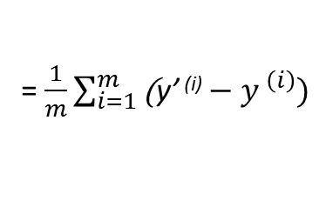
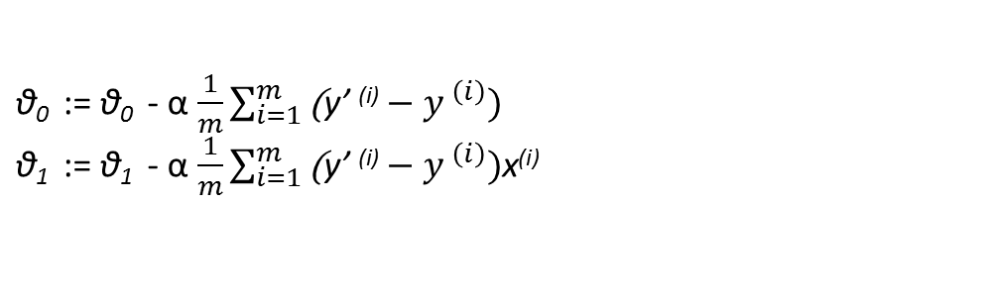










Gradient Descent for Linear Regression
$$J(\text{θ}\text{0}\text{,}\text{θ}\text{1})= \frac{1}{2m}\sum_{i=1}^{m}{{( {y′}^{ (i)} − y^{ (i)} )}^{2}}$$
$\frac{∂}{∂\text{θ}\text{0}}$ ($\frac{1}{2m}\sum_{i=1}^{m}{{( {y′}^{ (i)} − y^{ (i)} )}^{2}}$)
Algorithm:
- initialize $\text{θ}$ ’s randomly
- repeat until convergence {
$\text{θ}\text{0}$ := $\text{θ}\text{0}$ - α $\frac{∂}{∂\text{θ}\text{0}}J(\text{θ}\text{0}\text{,}\text{θ}\text{1}\text{)}$
$\text{θ}\text{1}$ := $\text{θ}\text{1}$ - α $\frac{∂}{∂\text{θ}\text{1}}J(\text{θ}\text{0}\text{,}\text{θ}\text{1}\text{)}$
Cost function:
$$\min_{\text{θ}\text{0}\text{,}\text{θ}\text{1}}{J(\text{θ}\text{0}\text{,}\text{θ}\text{1})}$$
= $\frac{∂}{∂\text{θ}\text{0}}$ ($\frac{1}{2m}\sum_{i=1}^{m}{(\text{θ}\text{0} \text{+} \text{θ}\text{1}\text{x}\text{(}\text{i}\text{) }{− y^{ (i)} )}^{2}}$)
Hypothesis : y’ ^{(i)} = h_{θ}(x^{(i)})=θ₀+θ₁x^{(i)}
= $\frac{1}{m}\sum_{i=1}^{m}{\text{(}\text{θ}\text{0} \text{+} \text{θ}\text{1}\text{x} \text{(}\text{i}\text{) }−y^{ \left(i\right)})}$
= $\frac{1}{m}\sum_{i=1}^{m}{\text{(}\text{y}\text{’ }\text{(}\text{i}\text{)}−y^{ \left(i\right)})}$
$\frac{∂}{∂\text{θ}\text{1}}$ ($\frac{1}{2m}\sum_{i=1}^{m}{{( {y′}^{ (i)} − y^{ (i)} )}^{2}}$)
= $\frac{∂}{∂\text{θ}\text{1}}$ ($\frac{1}{2m}\sum_{i=1}^{m}{(\text{θ}\text{0} \text{+} \text{θ}\text{1}\text{x}\text{(}\text{i}\text{) }{− y^{ (i)})}^{2}}$) $\text{x}\text{(}\text{i}\text{)}$
= $\frac{1}{m}\sum_{i=1}^{m}{\text{(}\text{θ}\text{0} \text{+} \text{θ}\text{1}\text{x} \text{(}\text{i}\text{) }−y^{ \left(i\right)})\text{x}\text{(}\text{i}\text{)}}$
$\text{θ}\text{0}$ := $\text{θ}\text{0}$ - α$\frac{1}{m}\sum_{i=1}^{m}{\text{(}\text{y}\text{’ }\text{(}\text{i}\text{)}−y^{ \left(i\right)}) }$
$\text{θ}\text{1}$ := $\text{θ}\text{1}$ - α$\frac{1}{m}\sum_{i=1}^{m}{\text{(}\text{y}\text{’ }\text{(}\text{i}\text{)}−y^{ \left(i\right)})\text{x}\text{(}\text{i}\text{)}}$
= $\frac{1}{m}\sum_{i=1}^{m}{\text{(}\text{y}\text{’ }\text{(}\text{i}\text{)}−y^{ \left(i\right)})\text{x}\text{(}\text{i}\text{)}}$
batch gradient descent

Slide 42

Gradient Descent for Linear Regression
$\text{θ}\text{0}$ := $\text{θ}\text{0}$ - α$\frac{1}{m}\sum_{i=1}^{m}{\text{(}\text{y}\text{’ (}\text{i}\text{)}−y^{ \left(i\right)}) }$
$\text{θ}\text{1}$ := $\text{θ}\text{1}$ - α$\frac{1}{m}\sum_{i=1}^{m}{\text{(}\text{y}\text{’ (}\text{i}\text{)}−y^{ \left(i\right)})\text{x}\text{(}\text{i}\text{)}}$

Slide 43
Q & A

